Slide 1

COLUMBIA ASIA HOSPITAL ANALYSIS - P Sakthi Ganesh

Slide 2
Problem Statement
You have been hired as a consultant data analyst by Columbia Asia Hospital. The Hospital is looking for key insights for the following objectives:
Assess the hospital's revenue generation
Insights about suitable departments for new hires
Strategies suggestions for patient discounts Your task is to perform data analysis and come up with a report in order to help the organization with the mentioned objectives.

Slide 3
Dataset Description
Date: This column contains date and time information without specifying AM or PM. The format is DD-MM-YYYY HH:MM.
Patient ID: Each patient is assigned a unique identifier, which seems to be in the format 124-62-3289.
Patient Gender: This column records the gender of the patient, denoted by 'M' for male and 'F' for female.
Patient Age: The age of the patients is listed in years.
Patient Sat Score: It seems to represent a satisfaction score given by or for the patient. However, the scores are single-digit, and it's not clear what the scale is.
Patient First Initial: This column contains the first initial of the patient's first name.
Patient Last Name: The surname of the patient is listed in this column.
Patient Race: The racial or ethnic background of the patient is recorded here, with categories such as 'White', 'African American', 'Asian', 'Native American/Alaska Native', and 'Two or More Races'.
Patient Admin Flag: This column contains boolean values ('TRUE' or 'FALSE') which might indicate whether the patient was admitted or some other administrative flag.
Patient Wait Time: Appears to indicate the time the patient waited, possibly in minutes, before being seen or processed.
Department Referral: This column lists the department to which the patient was referred, with entries such as 'General Practice', 'Orthopedics', 'Gastroenterology', or 'None' indicating no referral.
Doctor Name: Identifies the doctor who attended each patient.
Appointment Fees: The cost charged for a doctor's consultation.
Total Bill: The overall amount billed to the patient, including all services and charges.

Slide 4

Methodology
Data cleaning
In the "Patient Satisfaction Score" column, null values were replaced with 0 to ensure smooth analysis and prevent errors.
Data transformation
Date and Time were extracted into separate columns from the existing Date field for better analysis.
The "Patient Name" column was created by combining the first name initial with the last name to improve efficiency.
The "Gender" column was generated by converting abbreviations into full gender names.

Slide 5
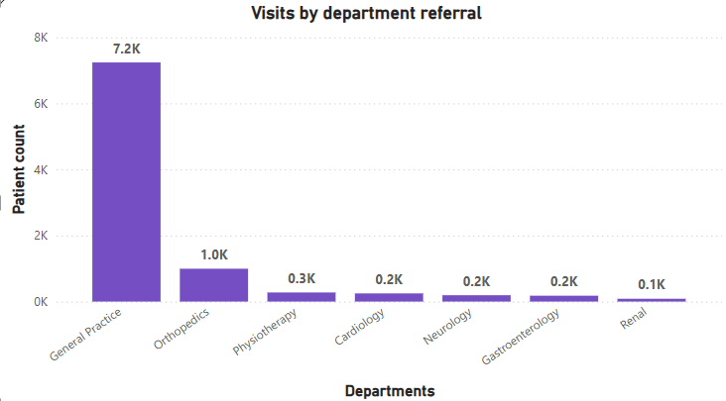
Patient visits by department referral
General Practice Dominates: 7.2K visits, far exceeding all other departments.
Significant Drop-Off: Orthopedics at 1.0K, shows a major decrease post-GP.
Low Specialized Referrals: Cardiology, Neurology, etc., all under 0.3K.
Implication: GP is key entry point, specialized departments may be underutilized.

Slide 6
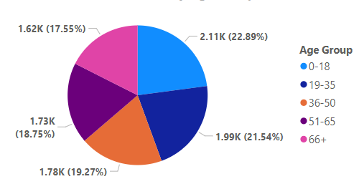
Patient demographics by age group
Relatively Even Distribution: The pie chart demonstrates a fairly even distribution of patient visits across all age groups. No single age group dominates significantly.
Slight Skew Towards Younger Adults: The 19-35 age group has the highest percentage (22.89%), suggesting a slightly higher utilization of services by this demographic.
Consistent Usage Across All Ages: All age groups show a substantial number of visits, indicating healthcare services are accessed by a diverse population.

Slide 7
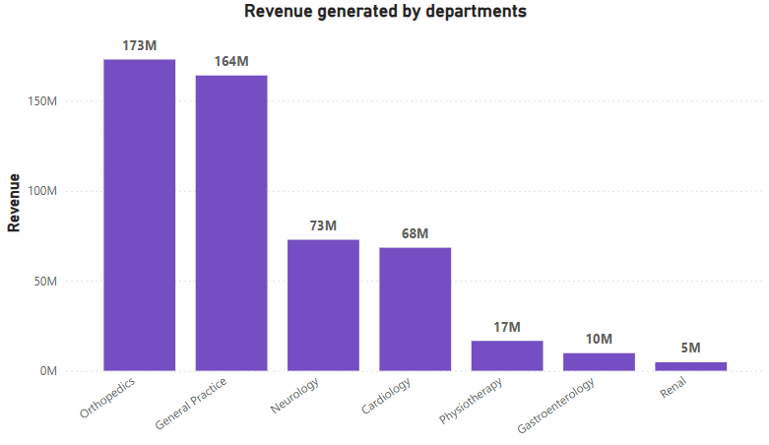
Revenue generated by each department
Orthopedics and General Practice Dominate: These two departments generate the vast majority of revenue, significantly outpacing all others.
Significant Revenue Decline: There's a steep drop in revenue after Cardiology, indicating a large gap between the top earners and the rest.
Low Revenue from Specialized Departments: Departments like Physiotherapy, Gastroenterology, and Renal contribute significantly less revenue.

Slide 8
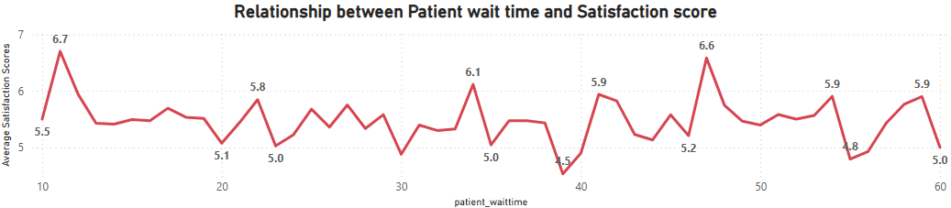
Relationship between patient wait time and satisfaction score
Weak Negative Correlation: While there are fluctuations, the graph generally suggests a weak negative correlation between patient wait time and satisfaction scores. Meaning, as wait times increase, satisfaction scores tend to decrease slightly, but not consistently.
Fluctuations and Variability: The graph shows significant fluctuations in satisfaction scores across different wait times, indicating that wait time is not the only factor influencing patient satisfaction.
Plateauing Effect: After a certain point (around 40 minutes), satisfaction scores seem to plateau, suggesting that beyond this threshold, further increases in wait time don't significantly impact satisfaction.

Slide 9
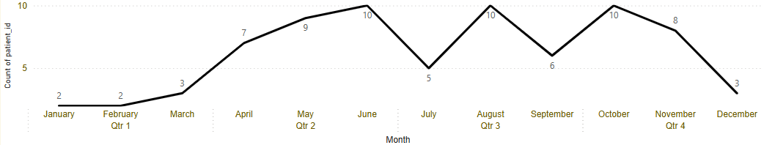
Patient visits throughout the year
Clear Seasonal Pattern: The graph reveals a distinct seasonal pattern in patient visits, with peaks and troughs throughout the year.
Low Start, Gradual Increase: The year begins with low patient visits, followed by a steady increase leading to a peak in the second quarter.
Mid-Year Dip: There's a significant drop in patient visits in July, suggesting a potential seasonal low or a specific event affecting healthcare utilization.
Second Peak and Decline: A second peak occurs in the third quarter, followed by a decline towards the end of the year.

Slide 10
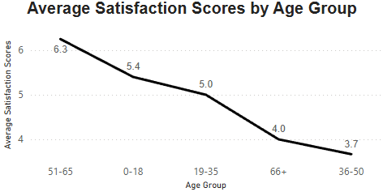
Average satisfaction scores by age group
Clear Downward Trend: There's a noticeable downward trend in average satisfaction scores as age decreases, with the highest scores among older age groups and the lowest among younger age groups.
Significant Drop in Younger Adults: The largest drop in satisfaction occurs between the 19-35 and 36-50 age groups, suggesting a potential disconnect or unmet needs in this demographic.

Slide 11
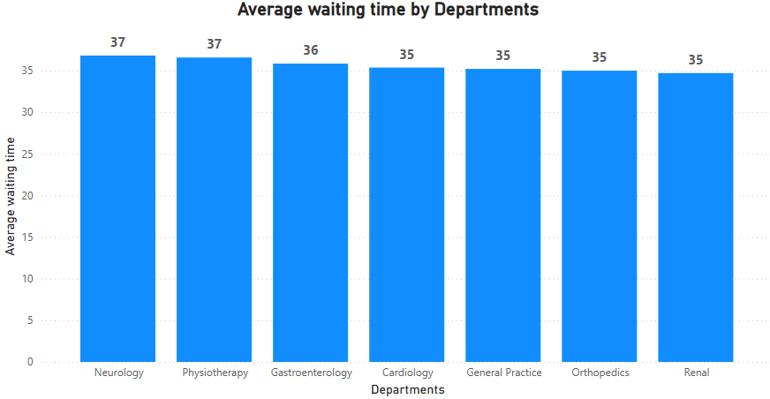
Average waiting time for each department
Consistent Waiting Times: The graph shows remarkably consistent average waiting times across all departments. There's only a very slight variation, suggesting a standardized or system-wide process influencing wait times.
Narrow Range: The wait times range only from 35 to 37 minutes, indicating a tightly controlled or managed waiting time system.
Potential System-Wide Issue: The consistency might indicate a system-wide bottleneck or a standard operating procedure that leads to these wait times, regardless of the department.

Slide 12
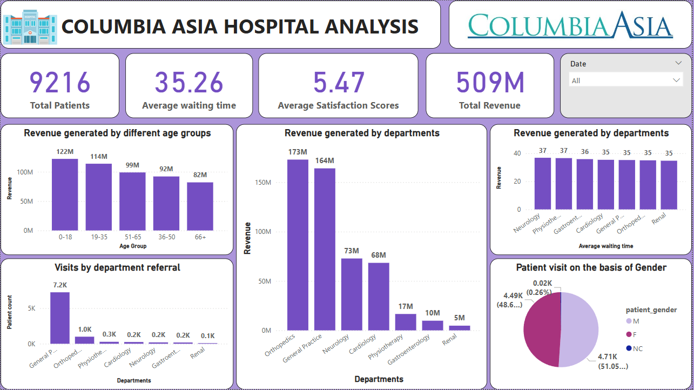
Main tab

Slide 13
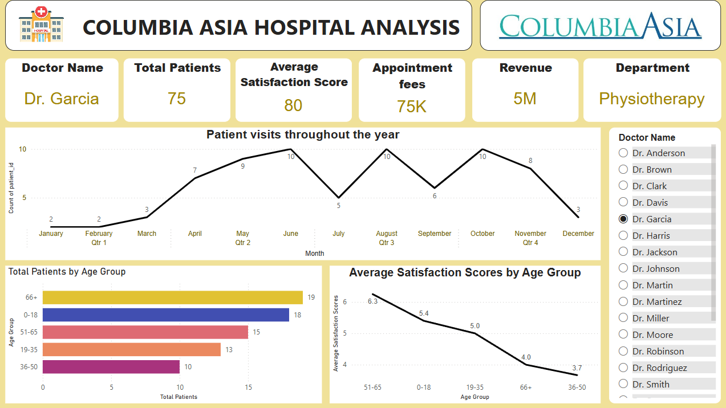
Doctor’s tab

Slide 14
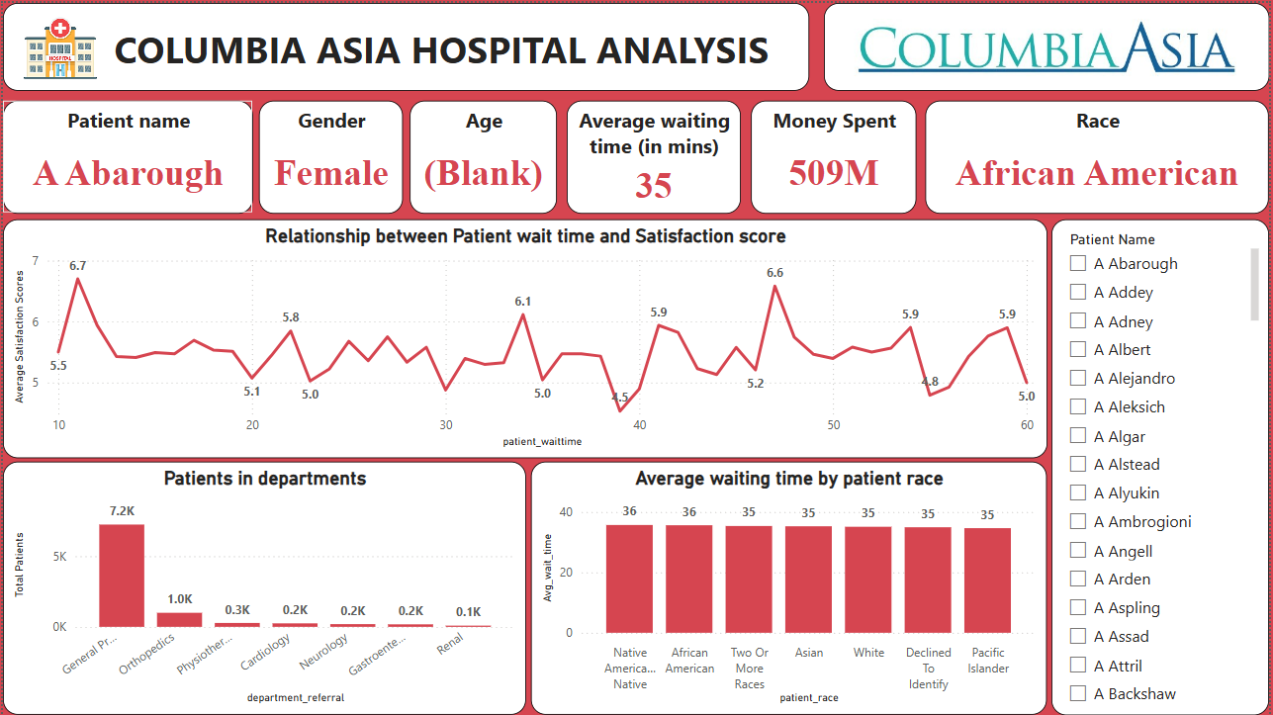
Patient’s tab

Slide 15
Recommendations
Staff Allocation:
Hiring additional doctors in high-traffic departments will improve patient care and reduce wait times.
The General Practice department requires more doctors due to the high number of patient visits.
Patient Satisfaction Score:
Minimizing wait times and offering discounts can enhance patient satisfaction and strengthen the hospital’s reputation.
Patient Feedback:
Encouraging patient feedback is essential, as 75% of patients have not provided their satisfaction scores.
Collecting feedback will help in identifying areas for improvement and implementing necessary actions.

Slide 16
Conclusion
Key Insights Identified:
The analysis revealed crucial trends, such as department-wise revenue, patient demographics, and satisfaction scores, providing valuable insights for informed decision-making.
Actionable Recommendations:
Strategies like optimizing staff allocation, enhancing patient feedback collection, and reducing wait times aim to improve efficiency and patient experience.
Strategic Path Forward:
These insights support the adoption of data-driven policies, ensuring a balance between financial sustainability and enhanced healthcare accessibility.

Slide 17
Thank you!

